Slide 1
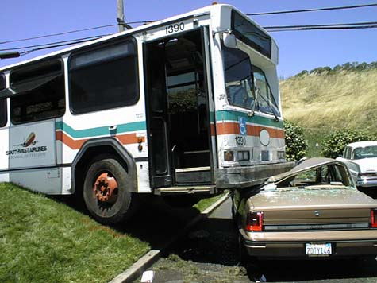
It was the Best of Bus, It was the Worst of Bus: Is Fixed Route Mass Street Transport a Public Good?
Michael
Munger

Slide 2
Market Failures
Public Goods
Externalities
Asymmetric Information
Natural Monopoly (Utilities)
(Equity Problems)
Misspecification of property rights
Failure to enforce property rights
In this context, why are buses a “government function”? Which market failure requires government provision?

Slide 3
Public Goods…
Zero marginal cost of production / non-rival consumption / no congestion
Costly exclusion / expensive or impossible to prevent citizens from consuming benefits if the public good is produced
Buses are clearly NOT public goods, since they fail on both counts

Slide 4
 | Excludable | Non-excludable
Rivalrous Consumption | Private Goods (Apples, Oranges) | Common Pool Resources (Fisheries, Atmosphere)
Non-Rival Consumption | Club Goods (Swimming Pools) | Public Goods (National Defense)
Where are buses, in this scheme?

Slide 5
Externalities
Road congestion from too many competing and redundant buses
Pollution
Destructive competition for passengers
Use of bus is a positive externality, since it reduces congestion and makes it cheaper for business to hire poor people from outlying areas.
So, maybe externalities…

Slide 6
But Maybe Just Collective, Rather Than. Public
Property of Choice Property of Good | Individual Decision: I can choose, alone and without interference | Collective Decision: Choices are made by a group, and are binding on all
Private Decision: My choice has no consequence for your welfare | Liberty of the individual: What socks should I wear? Whom should I marry? | Tyranny of the majority: Invasion of privacy Theft of property rights
Public Decision: My choices affect your welfare | Underinvestment, or else theft by the minority: Air or water pollution Education | Liberty of the group How much to spend on defense? How to take care of the poor?

Slide 7
A tale of two bus systems
It was the best of times (Transmilenio)
And it was the worst of times (Transantiago)
Why were these two bus systems so different?
The best of bus-- Transmilenio: Bogotá, Colombia: December 2000
The worst of bus--Transantiago: Santiago, Chile: February 2007

Slide 8
Transmilenio
Bogata, Colombia
Phased in slowly, over five years. Started with just two routes, Avenida Caracas y Calle 80.
Middle lanes of road, dedicated lanes.
“Zona Pagada,” out of the rain, less crowding.
"Bus Rapid Transit" system, actually more comparable to a subway

Slide 9
http://vimeo.com/28126860

Slide 10
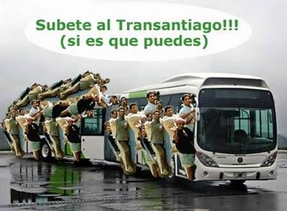
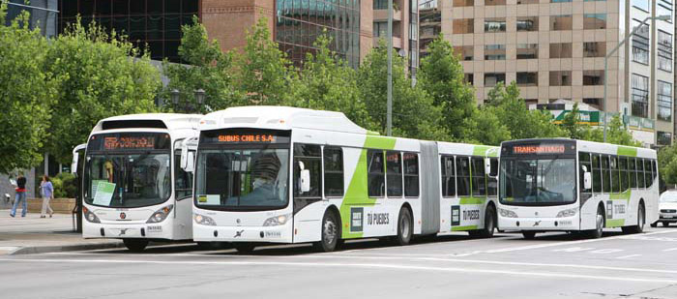
BAD: Transantiago, Santiago de Chile

Slide 11
Problems with old system
Danger from accidents
Chaos at bus stops
Pollution
Congestion from too many buses/cars
Profits (WTF?)
BUT…passed money forward, change back.

Slide 12
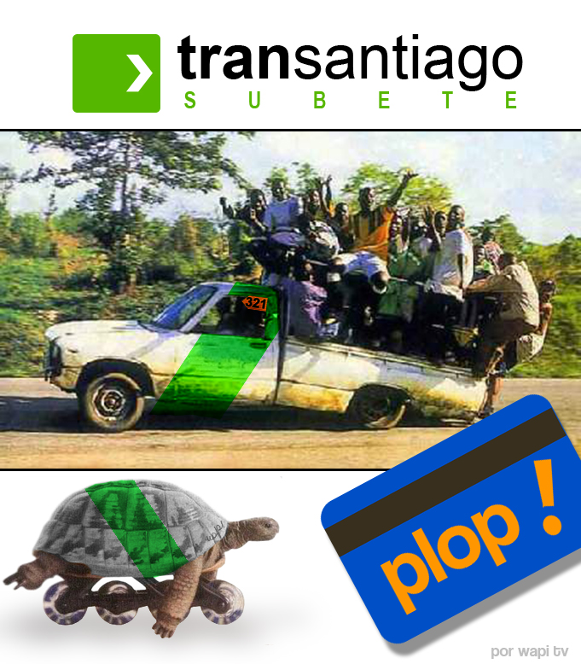
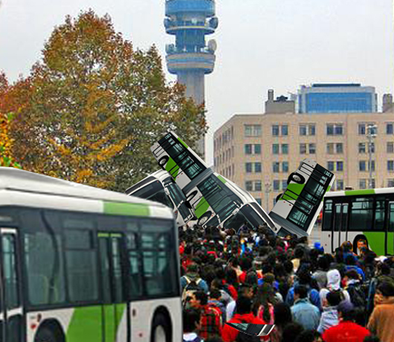
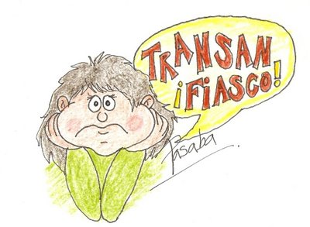
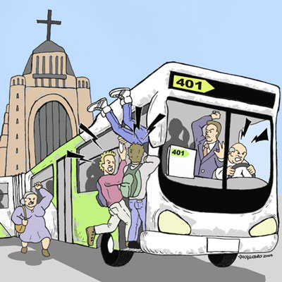

Slide 13
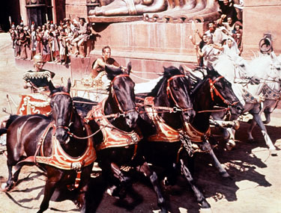
TranSantiago
Two Problems: Greed and Danger
Greed: Profits of $60 m US per year
Danger: Accidents, because curb rights
were
common
pool

Slide 14
NPR Story, October 2007
While a state-of-the art system installed in Chile has reduced pollution in Santiago, a bungled adjustment has also left millions of passengers reeling — and hundreds of others suing the government.
The new system may be generating less pollution, but it is also generating mountains of complaints. What was once a 40-minute trip can now take 2 hours. As a result, commuters are losing their jobs for being late, or must change jobs because routes have changed.

Slide 15
NPR Story (Continued)
So troubled is Santiago's new mass transit system, known as Transantiago, that President Michele Bachelet made an unusual admission just days after its disastrous roll-out. "It is not common for a president to stand before the nation and say 'Things haven't gone well," Bachelet said in Spanish. "But that is exactly what I want to say in the case of Transantiago. The inhabitants of Santiago, especially the poorest," Bachelet said, "deserve an apology."

Slide 16
Time Mag, 12-07: “The Mass Transit System From Hell”
Amid the apartment blocks and flyovers of the Chilean capital, Monica Eyzaguirre joins the snaking line of people at a bus stop, unfolds her newspaper & prepares for a long, long wait. "I hate Transantiago with every bone in my body," she says of the city's widely despised new transit system, watching a bus heaving with passengers trundle towards her down a congested road. "I used to take one bus to work and now I have to take three. It's made the lives of millions of people more difficult and more miserable.“ Read more: http://www.time.com/time/world/article/0,8599,1694607,00.html#ixzz13eemmlVA

Slide 17
TranSantiago
Two Problems: Greed and Danger
Greed: Profits of $60 m US per year
Danger: Accidents, because curb rights were common pool

Slide 18
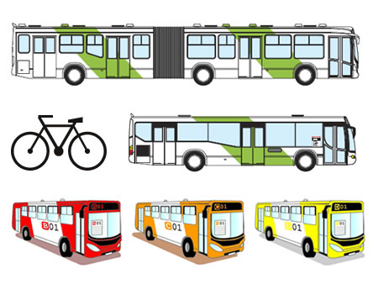
The Solution

Slide 19
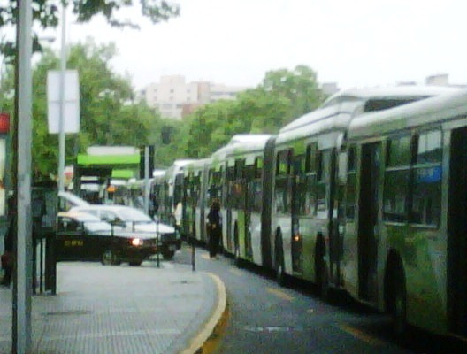
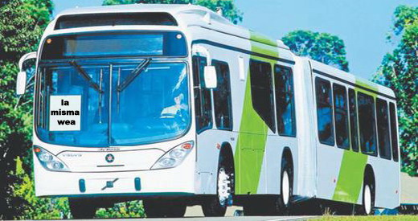
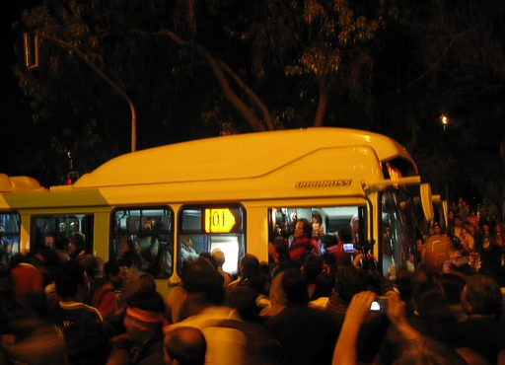
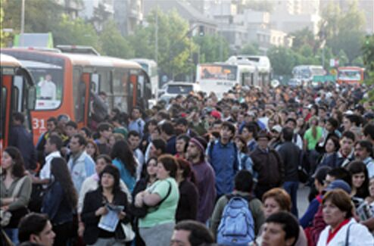
TranSantiago

Slide 20
Santiago Time Line
1973 (US-assisted, or at least approved) military coup, assassination of President Salvador Allende
1975 Metro opened
2000 More than 1,000 bus “companies” with more than 7,000 buses. Operated competing routes, different levels of service and fare structures. Pollution is severe, because of temperature inversion in valleys (Similar to Denver)
February 10, 2007: Transantiago! Private buses outlawed. You can’t hide…your publicize

Slide 21
City Fix Interview (3/2010): Planners’ Attitude…
TCF: Why did officials make the decision to open Transantiago without any bus lanes?
JCM: …There was a perception that the main goal of the system was not to save time, but to reduce accidents, prevent drivers from competing for passengers, and reduce noise and pollution. All these objectives were met from the beginning. But the system was performing so badly that the users could not appreciate these benefits in the face of the poor service they were experiencing.
(Juan Carlos Muñoz, PUC Planning/Transport)

Slide 22
Why a perception “not to save time…”
Because average commute times went from 40 minutes to an hour and 40 minutes, with variance of an hour?
Because at peak times you might wait for 2 hours, at busy stops?
Because in many cases the buses did not stop, even if they were only half full?
What fresh hell is this?

Slide 23
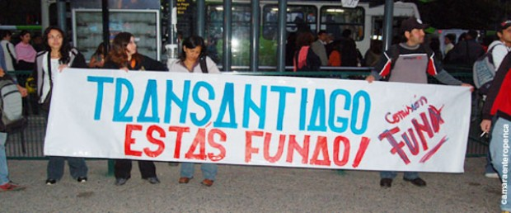
When the Great Day Came
February 10, 2007
8,000 buses were replace by 4,500 buses
Announcements made on television, but no one knew how it would work
Fare system not clear, drivers not trained to make change
Huge numbers of people drove cars
Metro ridership went up more than 50%, forcing waits of 20 minutes or more

Slide 24
What Went Wrong?
Remember, the problems had been greed, pollution, and danger. Solution was to make it public.
Routes
Incentives/Greed
Profits
Social Capital

Slide 25
Santiago Bus Route Systems
Old System: Redundancies, Demand-driven | New System: Planned, “Not to save time”
“I used to take one bus to work, and now I have to take three”

Slide 26
Comparisons
Transantiago Standard road buses, few stops, crowded Limited or broken zona pagada, loading is chaotic and often violent Functions as “alimentador” system for Metro Metro system functions well, heavily used. Problems are with bus system 2.3 million daily riders on Metro, with 0.8 million on Transantiago 42% approval, up from 15% in 2008 | Transmilenio Troncal system (center/median, dedicated lanes) Shaded, pleasant zona pagada, functions well, reduces loading time significantly “Surface Subway,” or main BRT system for the city. Red buses, alimentadores green (also free) NOT COMPARABLE to Transantiago, should be compared instead to METRO! Nearly 1.5 million daily riders 6. 75% approval rating among citizens of Bogotá

Slide 27
What would an ideal system look like? Public or Private
Redundancy
Different levels of service, at different costs
Public enforcement of “curb rights”
Public enforcement of emissions standards

Slide 28
Could a private system work?
Problem is to prevent “overfishing” of the commons, while ensuring adequate supply
Public provision may be step too far in the direction of centralization, on the feeder lines.
Main system, in both cases, works well (BRT in Bogotá, Metro in Santiago).
But that means you can’t compare Transmilenio to Transantiago, directly.
Nonsense to think that “incentives matter” only in a private system. Fundamental insight of Public Choice is that people are people.

Slide 29
Could a private system work?
Problem is that public provision underprovides quantity, and does not provide optimal route service, on feeders (alimentadores).
Hayek: Calculation debate, local knowledge, can’t know demand for non-existent routes. Planners looking at map, private bus company looking at profits.

Slide 30
Could a private system work?
Three types of fixed costs, to prevent contestable markets pressures on prices
Licensing for emissions
Licensing for driver training, background checks
Curb rights: exclusive stops, rental or ownership agreements
Paid zone, or turnstiles

Slide 31
Could a private system work?
Tariff structure
Monthly, non-transferrable passes with deep discounts, to allow info on average ridership
Day passes or single trip passes that are transferrable
Integrated accounting system, touchless “SmartCards”
No route regulation, other than fixed costs listed on previous slide
How ensure low fares? Competition / vouchers for low-income riders; employer provision?

Slide 32
Questions for YOU
Are Roads Public Goods?
Is the theory that "government should provide all public goods, BUT only public goods" correct? (Other market failures are corrected by regulation or transfers; only public goods need to be provided by the state)
How does this compare with what we actually do?

